Slide 1
Stateflow Chart
Pick and Place Workflow
Move to reach position
Find Error using Computer Vision with Realsense Camera
Trajectory Planning Algorithm
Activate the gripper and pick up the object using the top end of the finger
Slide the object to the bottom of the gripper
Build Environment for Sim or CV, and plan the pick-up sequence
Identify the location and shape of object, and determining where to place
Move to place position
Home Position
Rotate to object pose that aligns the object with the hole on the shape sorting box
Use preassigned location and shape
Place the object, and deactivate the gripper
* Green shows the advanced features that might be added

Slide 2
Work
Robotic Arm control (Simulation + Hardware)
Gripper control (Simulation + Hardware)
Computer Vision

Slide 3
Timeline
Project | Student Group
Week 1 - Tuesday 2 May term begins properly | Meet with Client for full briefing on project, context and expectations. Write summary of meeting for discussion with IC supervisor. Attend Team building workshop (Thursday 4 May 11am in person)
Week 2 – 8 May | Clarify leaflet with client and supervisor and plan of work, justification of approach and proposed solutions
Week 3 – 15 May
Week 4 – 22 May
Week 5 | produce draft flyer for supervisor/client (By Friday 26 May 2023)
Week 6 | Groups submit 2pp A 4 flyer (Friday 9 June 2023)
Week 7 | Hackbooth Demonstration and poster presentation (Thursday 29 June 2023)
Week 8
Week 9 | submission of documentation and peer assessment (Friday 7 July 2023)
Week 10 | Submission of peer assessment and portfolio (Friday 14 July 2023)

Slide 4
Timeline Plan
Robotic Arm + Gripper
Intelligent arm Motion Planning
Robotic arm control
FK, IK, Joint Control
Integration of Vision and Motion
Gripper control
Intelligent Gripper planning
Import CAD,
Create a good simulation of gripper
Trajectory planning
(A*search?)
Computer Vision

Slide 5
Robotic Arm control
Perform Forward and Inverse Kinematics
Joint control
Simple trajectory Planning
Advanced Features:
Using intelligent algorithms for trajectory Planning

Slide 6
Gripper
Decide on gripper base (he showed us one in the lab I think?)
Import CAD files
Produce simulation of gripper (probably more steps to this...)
Gripper control + trajectory planning (A* search??)
Clockwise and anticlockwise rotation
Up and down the slide
Advanced Features:
Machine learning control?? (Use Unity engine)

Slide 7
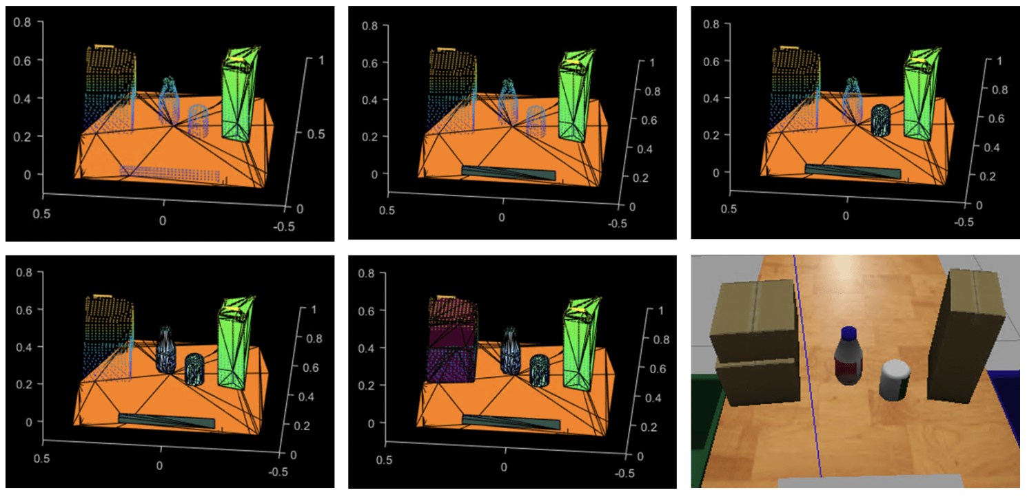
Computer Vision
Reduce the gripper error
Realise the Hybrid Method
Localization and identification of the object
Computer vision – 2D color or shape identification
CNN 3D object identification
Reference example:
Pick-and-Place Workflow in Gazebo Using Point-Cloud Processing and RRT Path Planning

Slide 8
Questions
Trajectory planning (do we need to do it our own or use A*)
When should we do computer vision and how?
Are we gonna follow the timeline provided by the Uni?
What should we do about the flyer/documentation/presentation? Any requirements or criteria?

